Slide 1

DATA HIDING & PROTECTION
In java

Slide 2
What type of programming Language is java?
1.Object-Oriented
2.Procedural-oriented

Slide 3
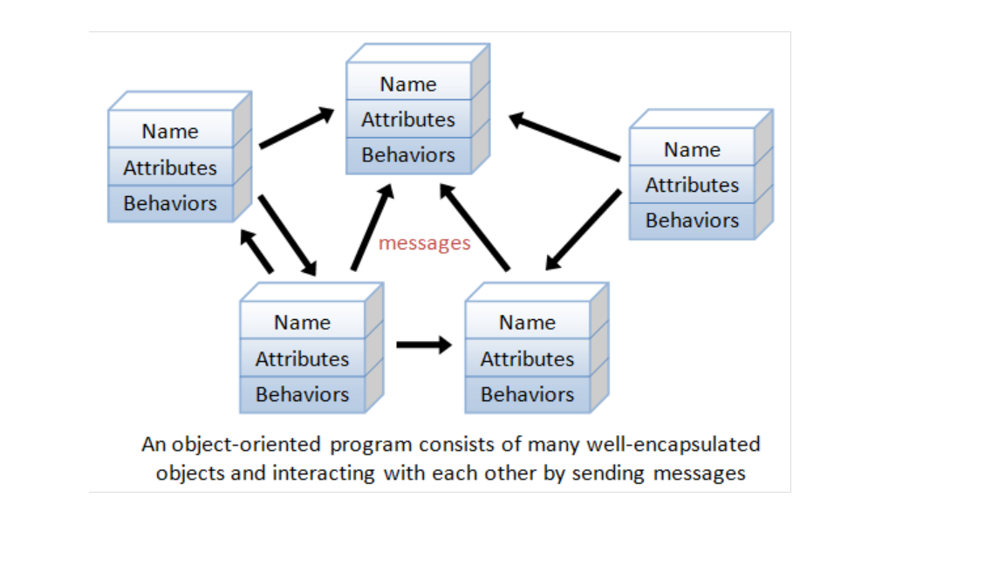
YES, it is object-oriented programming language.
OOP concepts in java are the main ideas behind java’s Object oriented programming.
OOP concepts like Data_Hiding,Abstraction,Encapsulation are the key concepts of protecting data in java language.

Slide 4
Data_Hiding :
Out side classes can’t access the data present in a specified class which is having private variables or methods (behaviours).
Public class Employee
{
Private double balance; //accessible with in the class only
Public double getBalance() //to get access the above private variable
{
//validation
Return balance;
}
}

Slide 5
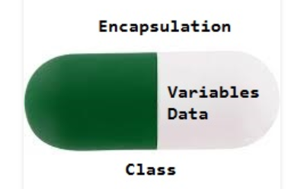
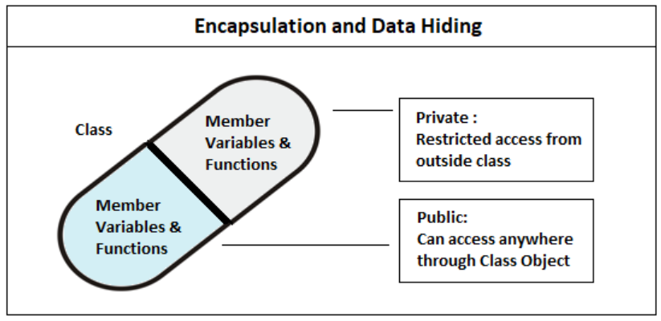
Abstraction :
Hides internal implementation and just highlights the set of services what we are offering is known as abstraction.
Example: ATM Services
Encapsulation :
Process of binding the data members and corresponding methods (behaviour).
To hide details of structure and implementation.

Slide 6
Public class Employee
{
Private double balance;
Public double getBalance()
{
//validation
Return balance;
}
Public void set balance(double balance)
{
This.balance =balance;
}
}
In java every class it self is an example of encapsulation.
Class student
{
Data Members
+
Methods
}
If any component fallows data_hiding and abstraction such type of component is said to be encapsulated component.

Slide 7
Advantages :
1. We can achieve security.
2. Enhancement will be easy.
3. It improves maintainability of the application.
Disadvantages :
It slows down the performance and execution of application

